Slide 1
HTML
Դաս։ 08 CSS Flexbox

Slide 2
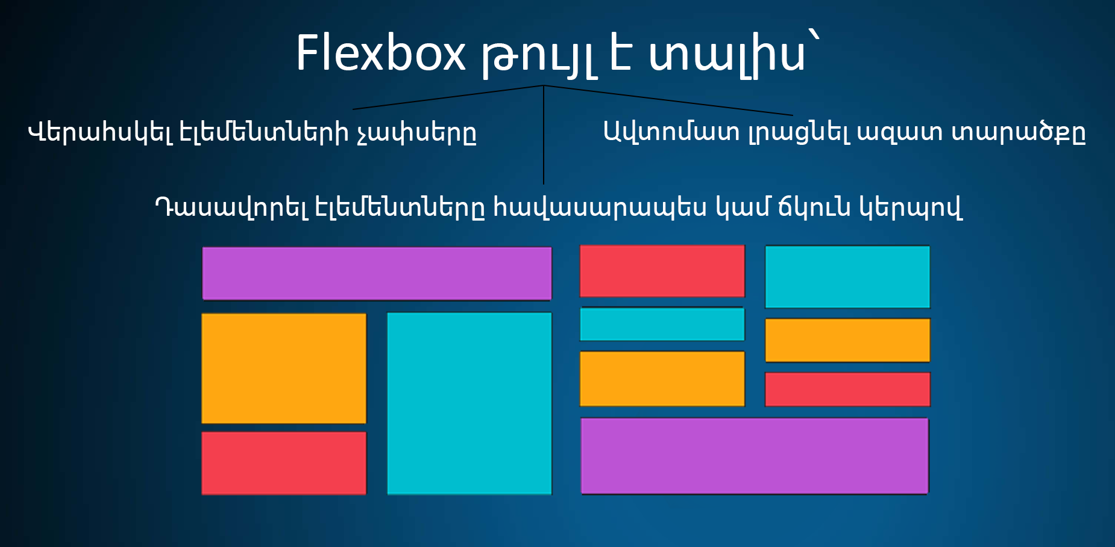
Flexbox

Slide 3
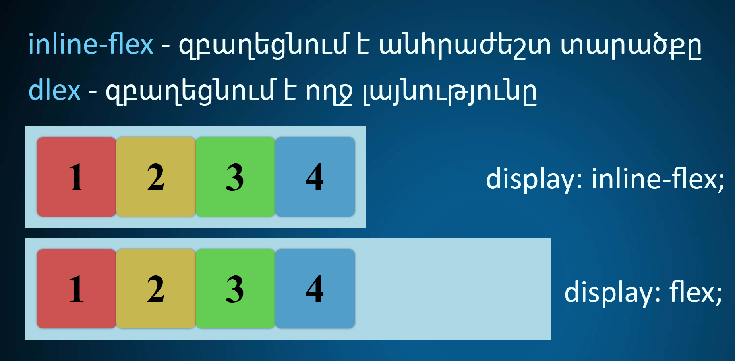
Flex Container

Slide 4
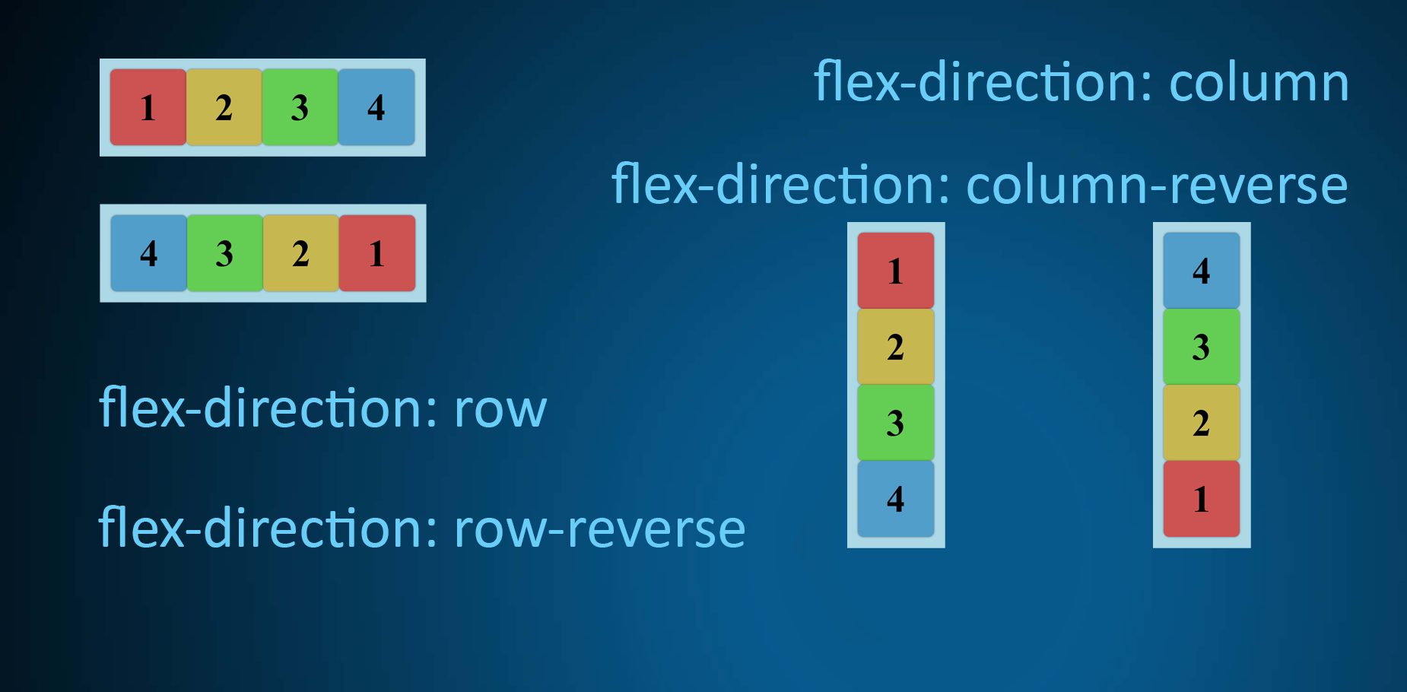
Flex Direction

Slide 5
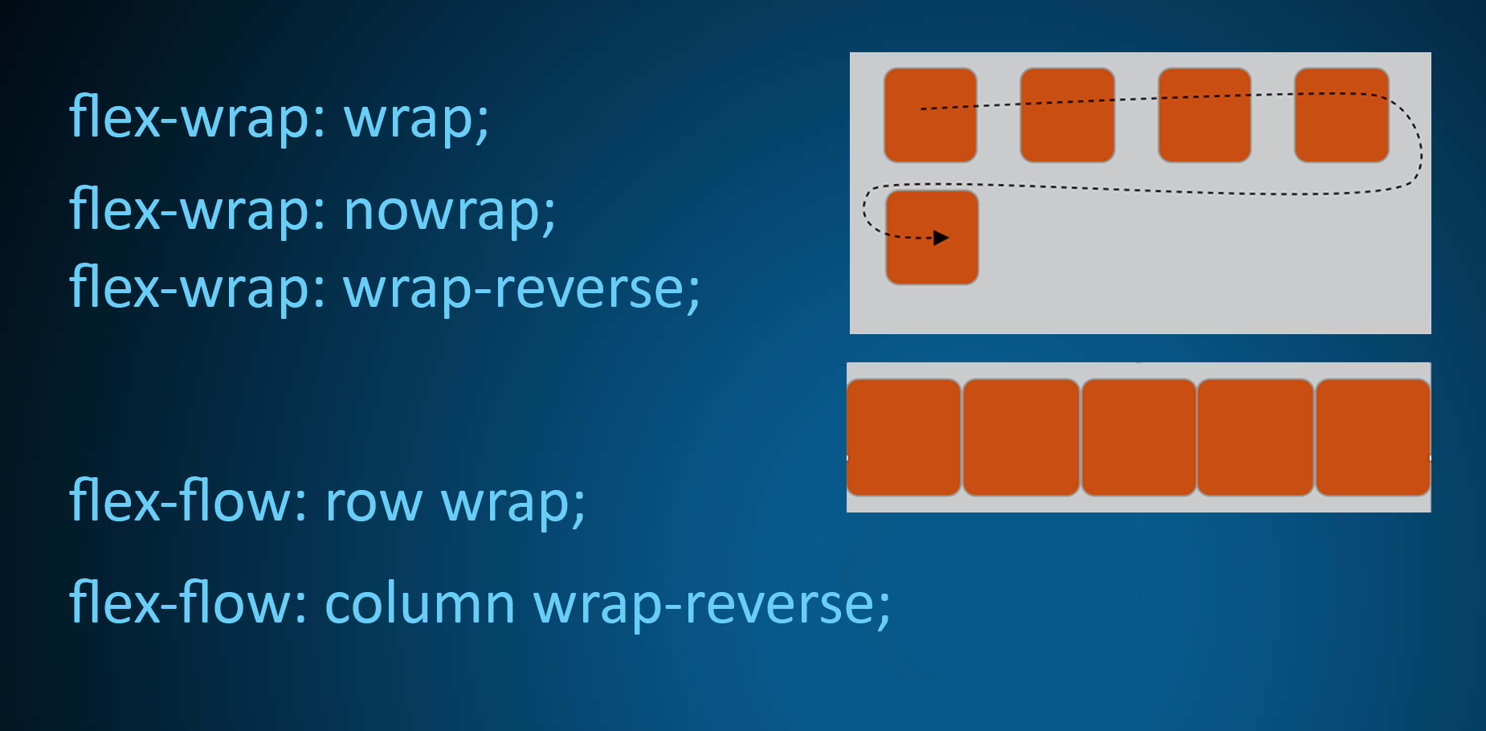
Flex Wrap

Slide 6
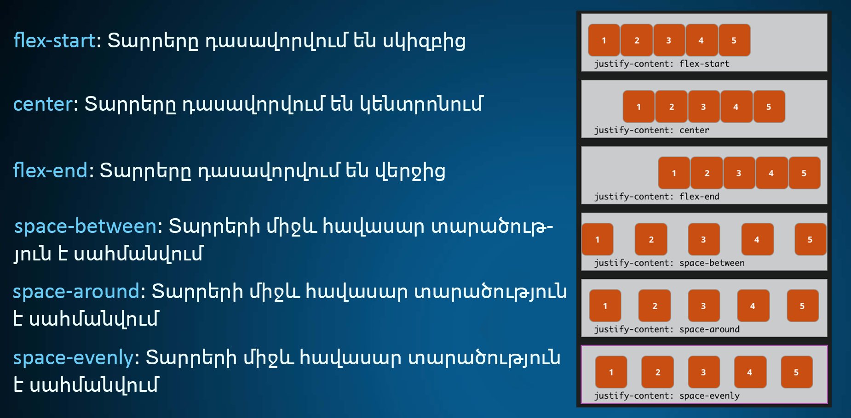
Justify Content

Slide 7
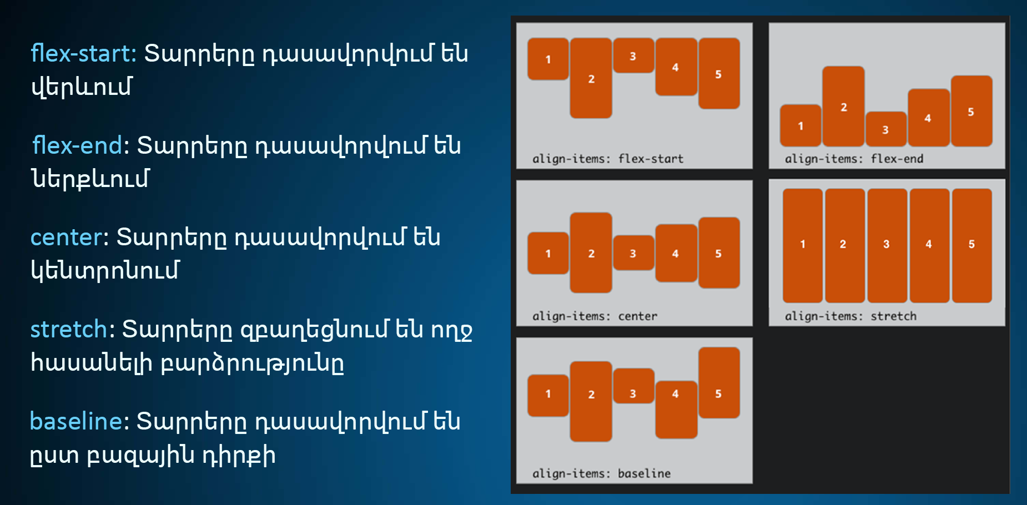
Align Items

Slide 8
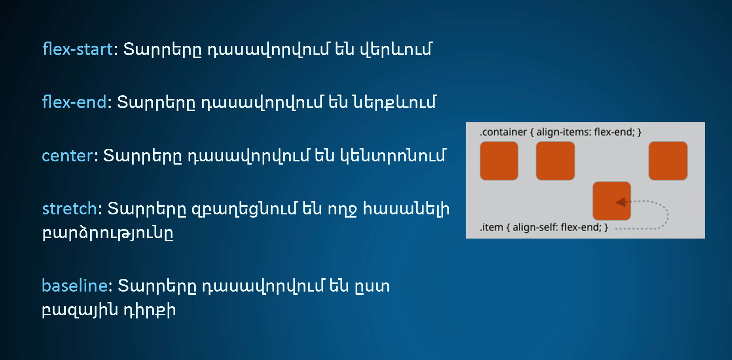
Align Self

Slide 9
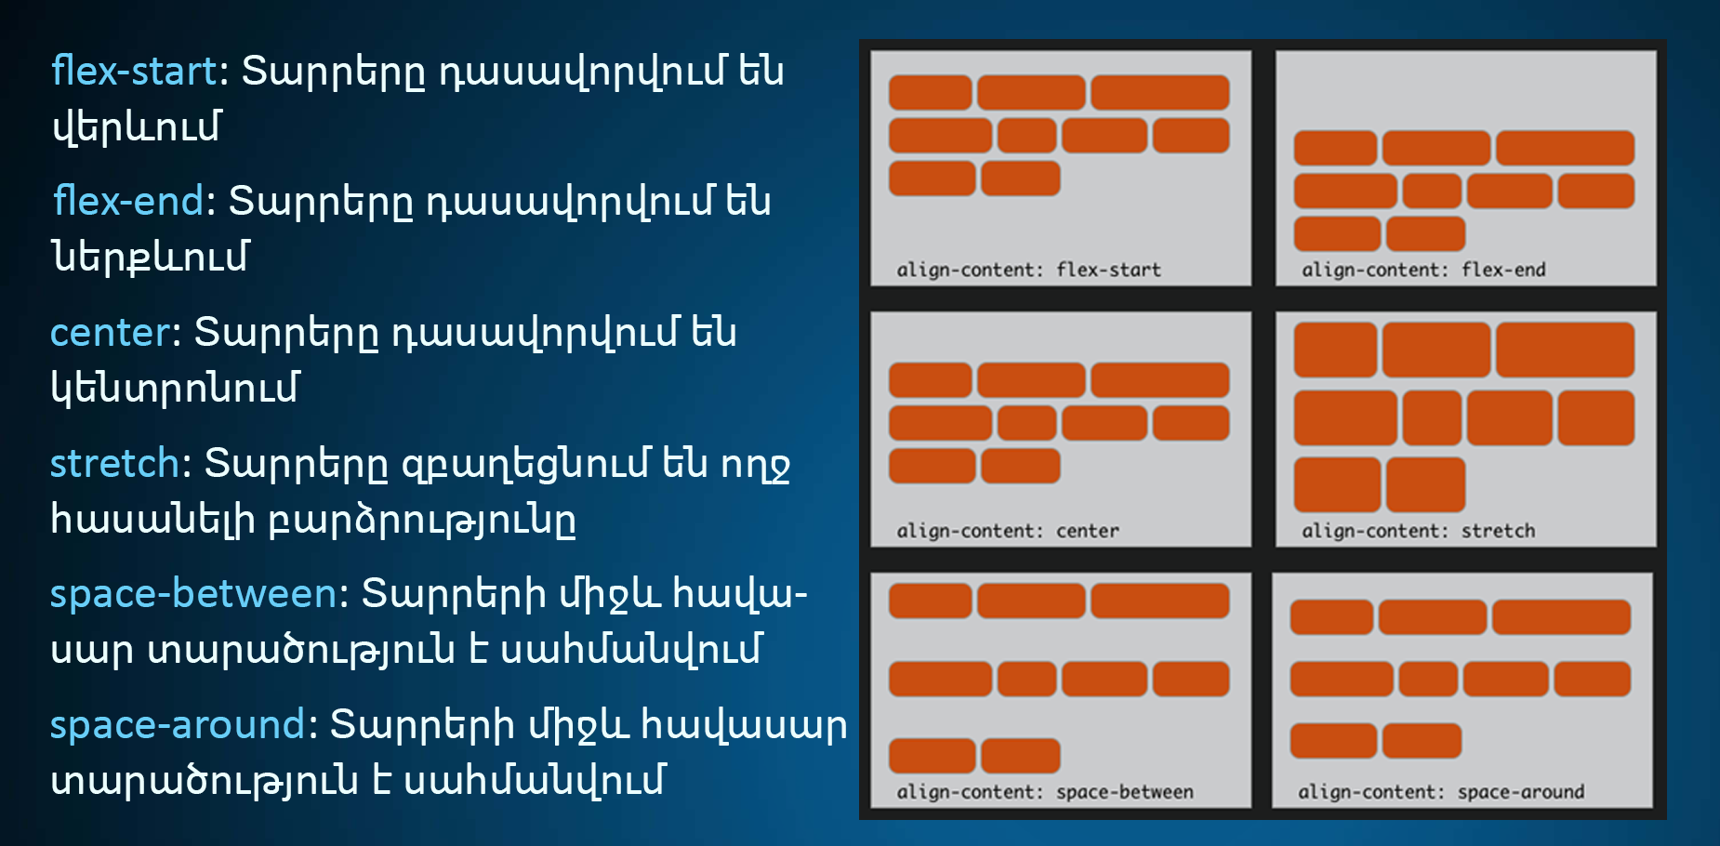
Align Content

Slide 10
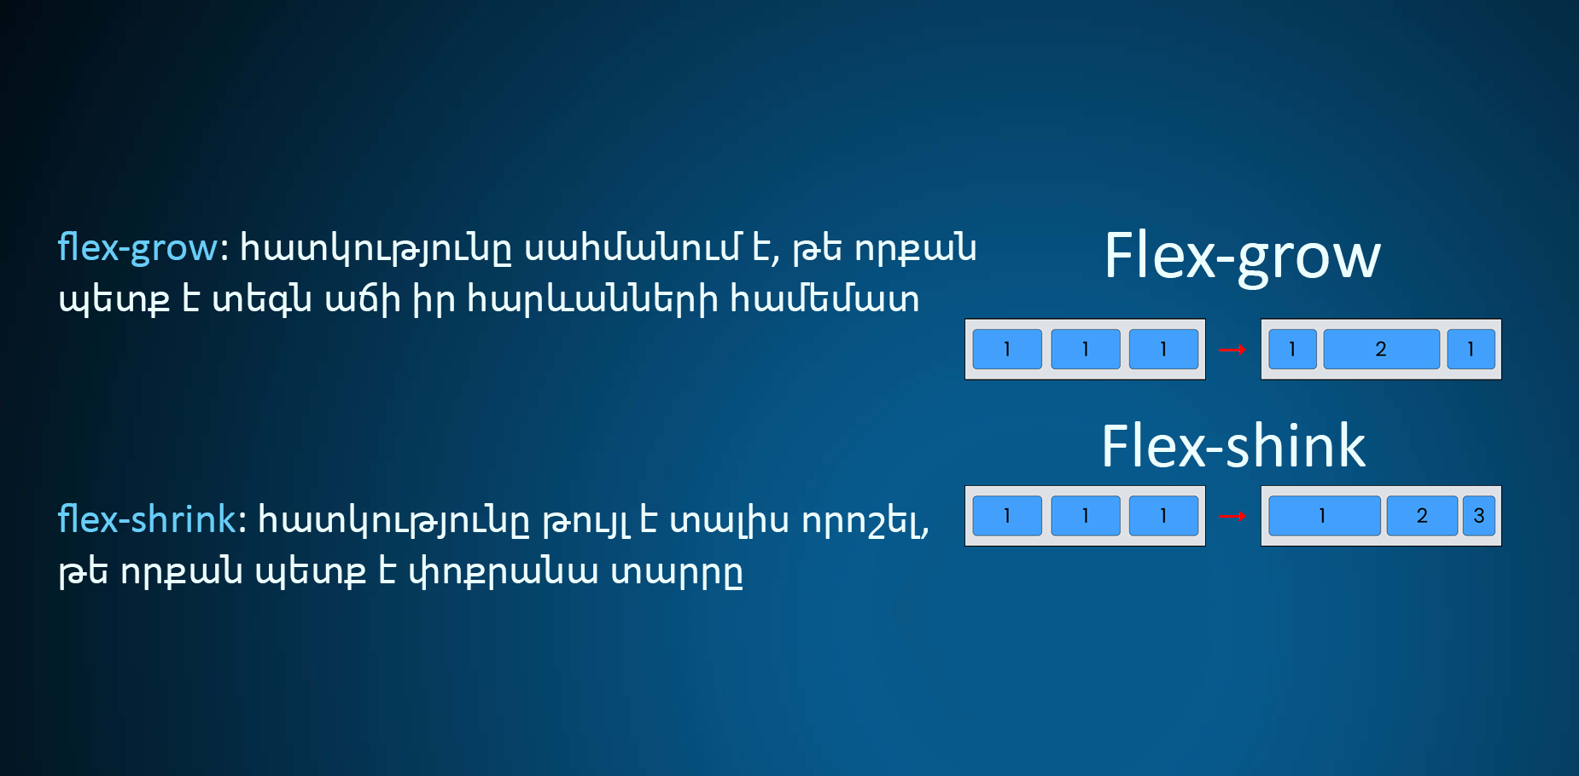
Flex grow, Flex shink

Slide 11
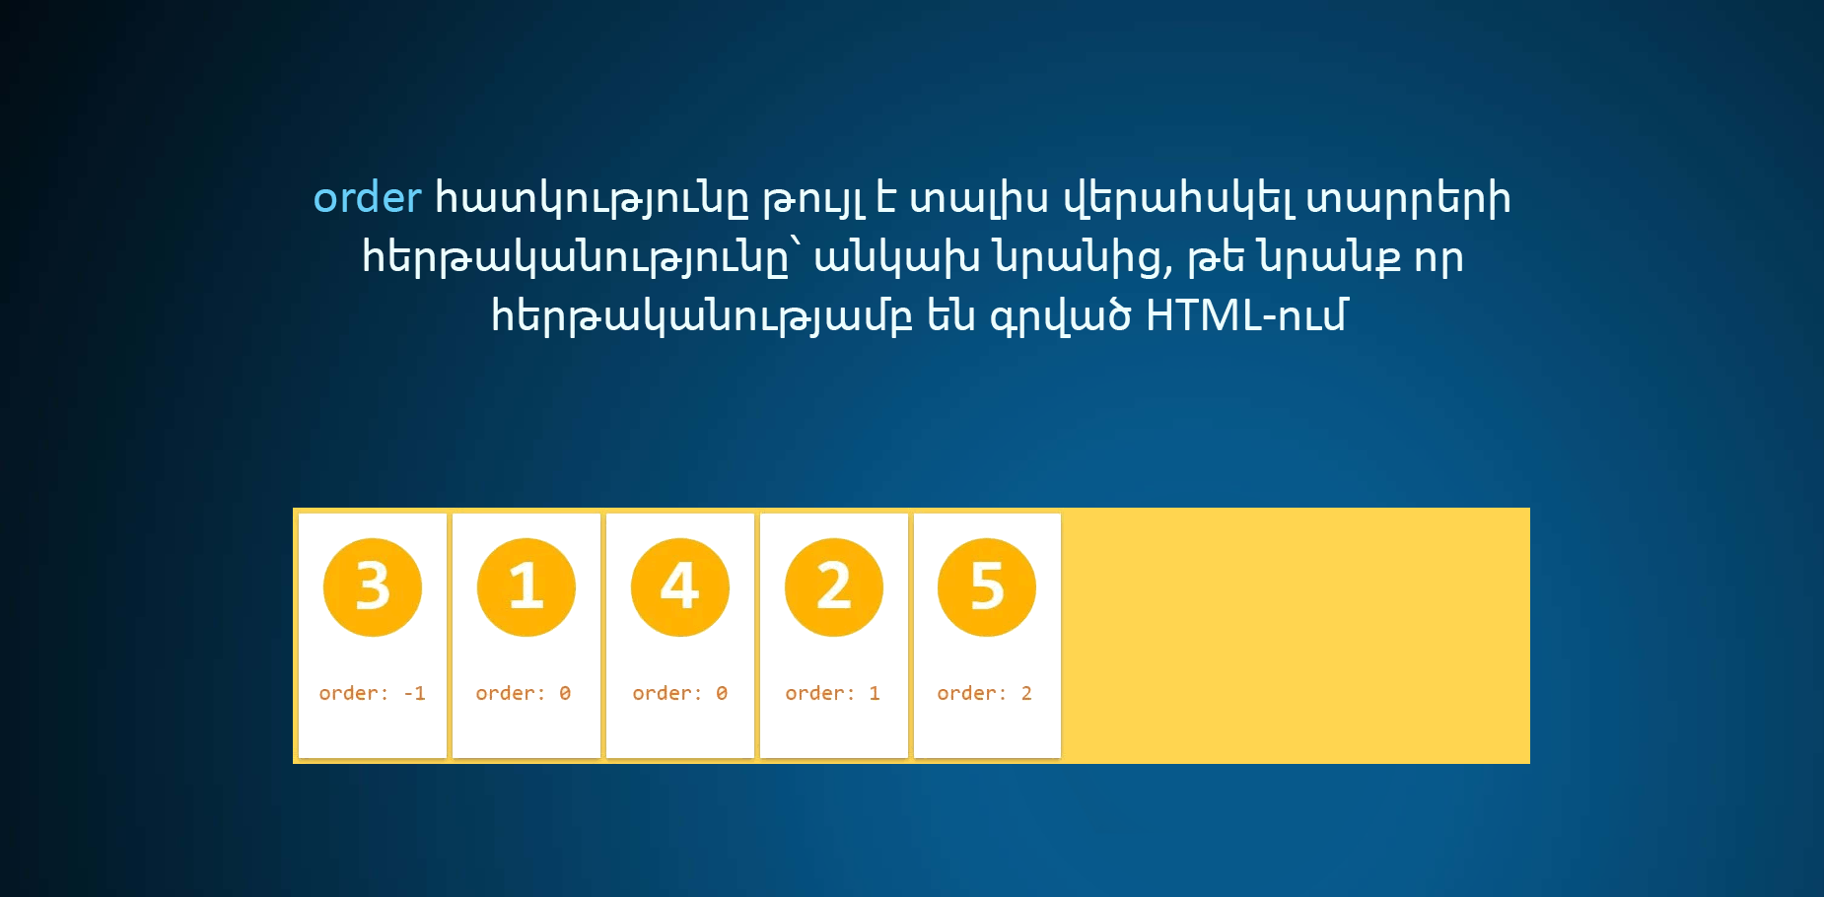
Flex order

